Slide 1

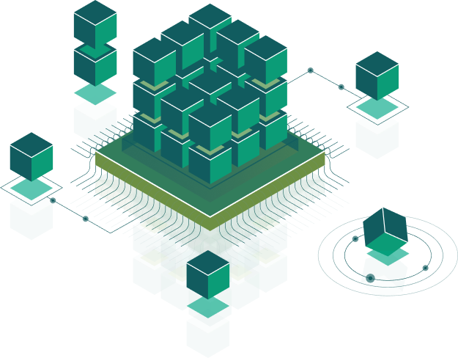
REST API, Socket, HTTP
Speaker:
Name

Slide 2

What is a REST?
Representational State Transfer (REST) is a software architectural style that defines a set of constraints to be used for creating Web services.
REST was defined by Roy Fielding, a computer scientist. He presented the REST principles in his PhD dissertation in 2000.
Most of modern REST APIs uses JSON data format.

Slide 3
REST Client on Android
API requests, on Android, can be made by Retrofit library.
Retrofit provides you choice what library to use for mapping, which client should be used for requests and Interceptors (for auth, tracking and other).
Client: sends requests to backend servers and receives responses.
Request: http request
Models: classes describes response/request models of our application.
Services: interfaces which describes each request (path, models and parameters).
Interceptor - calls before each request, uses for add auth headers for each request, tracking response/request, etc…

Slide 4
Required Permissions
To perform network operations in Android, your application must include certain permissions. The ACCESS_NETWORK_STATE permission is required for your application to check the network state of the device, while the INTERNET permission is required for your application to access the Internet.
<uses-permission android:name="android.permission.ACCESS_NETWORK_STATE" />
<uses-permission android:name="android.permission.INTERNET" />

Slide 5
Check Network Connection
The following code checks the network connection status:
private fun isNetworkConnected(): Boolean {
val connectivityManager = getSystemService(Context.CONNECTIVITY_SERVICE) as ConnectivityManager
val networkInfo = connectivityManager.activeNetworkInfo
return networkInfo != null && networkInfo.isConnected
}

Slide 6
Client
Client: uses for communicate between client and server.
OkHTTP is an open source project designed to be an efficient HTTP client. To add library to the project
implementation 'com.squareup.okhttp3:okhttp:3.12.0'
Sample of okhttp client for https://restcountries.eu
val okHttpClient = OkHttpClient.Builder()
.callTimeout(20, TimeUnit.SECONDS)
.connectTimeout(20, TimeUnit.SECONDS)
.build()

Slide 7
Http Request
Http Request - a request message from a client to a server includes, within the first line of that message, the method to be applied to the resource, the identifier of the resource, and the protocol version in use.
var url = "https://restcountries.eu/rest/v2/all"
var request = Request.Builder()
.url(url)
.build()
Notes:
https://www.vogella.com/tutorials/JavaLibrary-OkHttp/article.html https://o7planning.org/en/10527/android-networking-tutorial https://restcountries.eu/#rest-countries-users

Slide 8
Models
Models: classes describes response/request models of our application. Gson is a Java library that can be used to convert Java Objects into their JSON representation. Add library to the project
implementation 'com.google.code.gson:gson:2.8.5'
The sample above describes countries model for https://restcountries.eu
data class Country(
@SerializedName("name") val name: String,
@SerializedName("topLevelDomain") val topLevelDomain: List<String>,
@SerializedName("region") val region: String?
)

Slide 9
Interceptors
Interceptor - calls before each request, uses for add auth headers for each request, tracking response/request, etc…
class AuthInterceptor : Interceptor {
override fun intercept(chain: Interceptor.Chain): Response {
var request = chain.request()
val newBuilder = request.newBuilder()
newBuilder.addHeader("Authorization”, "Bearer ${PreferencesUtils.token}")
request = newBuilder.build()
return chain.proceed(request)
}
}

Slide 10
Service Retrofit
Service: it’s an Interfaces which describes each request (path, models and parameters). Retrofit turns your HTTP API into a Java interface.
The sample above describes countries service for https://restcountries.eu
interface CountriesApiService {
@GET("rest/v2/all")
fun getAllCountries(): Call<List<CountryBean>>
@GET("rest/v2/name/{name}")
fun searchCountry(
@Path("name") name: String
): Call<CountryBean>
}

Slide 11
What is a Socket?
Sockets allow communication between two different processes on the same or different machines. To be more precise, it's a way to talk to other computers using standard Unix file descriptors. In Unix, every I/O action is done by writing or reading a file descriptor. A file descriptor is just an integer associated with an open file and it can be a network connection, a text file, a terminal, or something else.

Slide 12
WebSocket
Websocket have a lot of callbacks like “onClosing”, “onMessage”, etc., you should override methods and it looks a little bit complex:
val client = OkHttpClient()
val request = Request.Builder().url("ws://echo.websocket.org").build()
val listener = EchoWebSocketListener()
val ws = client?.newWebSocket(request, listener)
client?.dispatcher()!!.executorService().shutdown()
class WebsocketEventsListener: WebSocketListener() {
override fun onClosed(webSocket: WebSocket, code: Int, reason: String) {
super.onClosed(webSocket, code, reason)
}
override fun onClosing(webSocket: WebSocket, code: Int, reason: String) {
super.onClosing(webSocket, code, reason)
}
override fun onFailure(webSocket: WebSocket, t: Throwable, response: Response?) {
super.onFailure(webSocket, t, response)
}
}

Slide 13
Socket.IO
Socket.IO - it’s a library which basically works with websockets, but encapsulates this logic and provides better work interface to a developer. Unlike a WebSocket - no need to implement massive callback from socket client. This library provides you a reconnecting feature, it will reconnect automatically if connection was dropped.
The sample of listening for same events on Socket.IO:
socket?.on(Socket.EVENT_ERROR, {
// Do something with data array
})?.on(Socket.EVENT_DISCONNECT, {
// Do something with data array
})?.on(Socket.EVENT_ERROR, {
// Do something with data array
})

Slide 14

Thank you!

